Slide 1
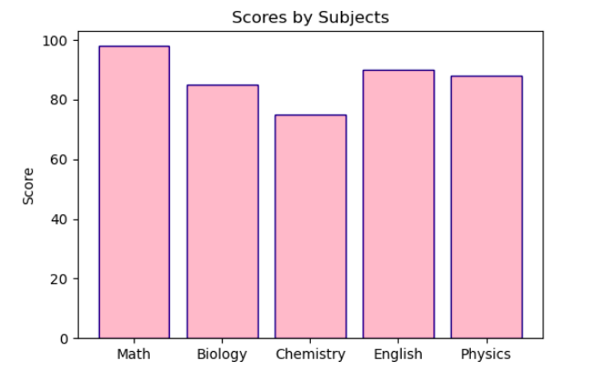

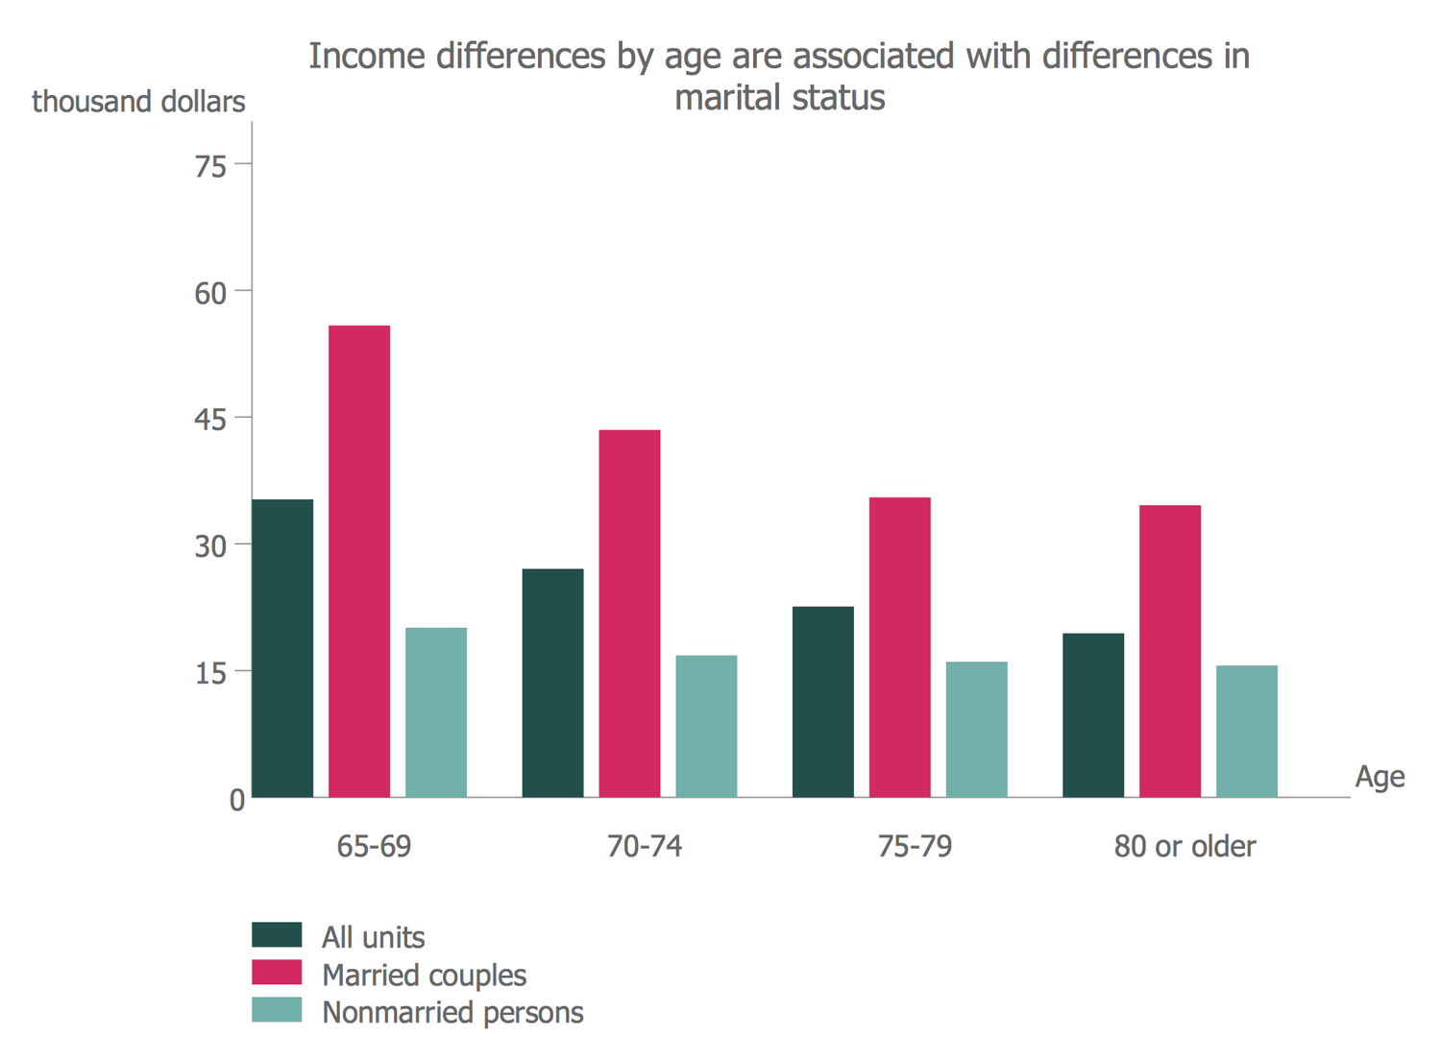
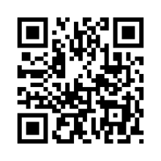
Logo
Poster Title Goes Here
Logo
Logo
Authors¹
hEDS
Logo
¹Affiliations
INTRODUCTION
METHODS
Use incomplete sentences
Smallest size body text 36
Keep word count to minimum
Image
Step 1
Step 2
Step 3
Fig X: sentence long description of image/figure. Min size 18.
Image
Fig X: sentence long description of image/figure. Min size 18.
Fig X: sentence long description of image/figure. Min size 18.
Fig X: sentence long description of image/figure. Min size 18.
Fig X: sentence long description of image/figure. Min size 18.
Image
Use incomplete sentences
Smallest size body text 36
Keep word count to minimum
Use incomplete sentences
Smallest size body text 36
Keep word count to minimum
Fig X: sentence long description of image/figure. Min size 18.
RESULTS
CONCLUSIONS
Table 1: Title
Use incomplete sentences
Smallest size body text 36
Keep word count to minimum
Use incomplete sentences
Smallest size body text 36
Keep word count to minimum
Category | Case 1 | Case 2 | Case 3 | Case 4
Category 1 | X | X | X | X
Category 2 | X | X | X | X
Category 3 | X | X | X | X
Category 4 | X | X | X | X
Category 5 | X | X | X | X
Category 6 | X | X | X | X
Category 7 | X | X | X | X
Figure 1.
Figure 2.
Figure 3.
ACKNOWLEDGEMENTS
REFRENCES
w
This is the one section you can use complete sentences to thank those that helped you on your project. Include whoever you would like. Additionally, don’t forget about your logos. You need the KEYS, BIO5, and Ken R. Coit College of Pharmacy logo and those required by your lab.
Fig X: sentence long description of image/figure. Min size 18.
Fig X: sentence long description of image/figure. Min size 18.
Fig X: sentence long description of image/figure. Min size 18.

